Slide 1
Organ Transplantation in Wan Fan Hospital
Ming-Che Lee, M.D.
Deputy superintendent, Wan Fang Hospital, TMU, Taipei, Taiwan
Director, TMU Organ Procurement Organization, Taipei, Taiwan
Director, Organ Transplantation Center, Wan Fang Hospital, Taipei, Taiwan
Chairman, Department of Surgery, Wan Fang Hospital, TMU, Taipei, Taiwan
Professor of Surgery, School of Medicine, College of Medicine, TMU, Taipei, Taiwan
2023 Taiwan-Somaliland Medical Conference, August 13rd 2023, Hargeisa, Somaliland

Slide 2
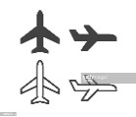
> 5100 miles, 20 hr. 10 min. by flight
2

Slide 3
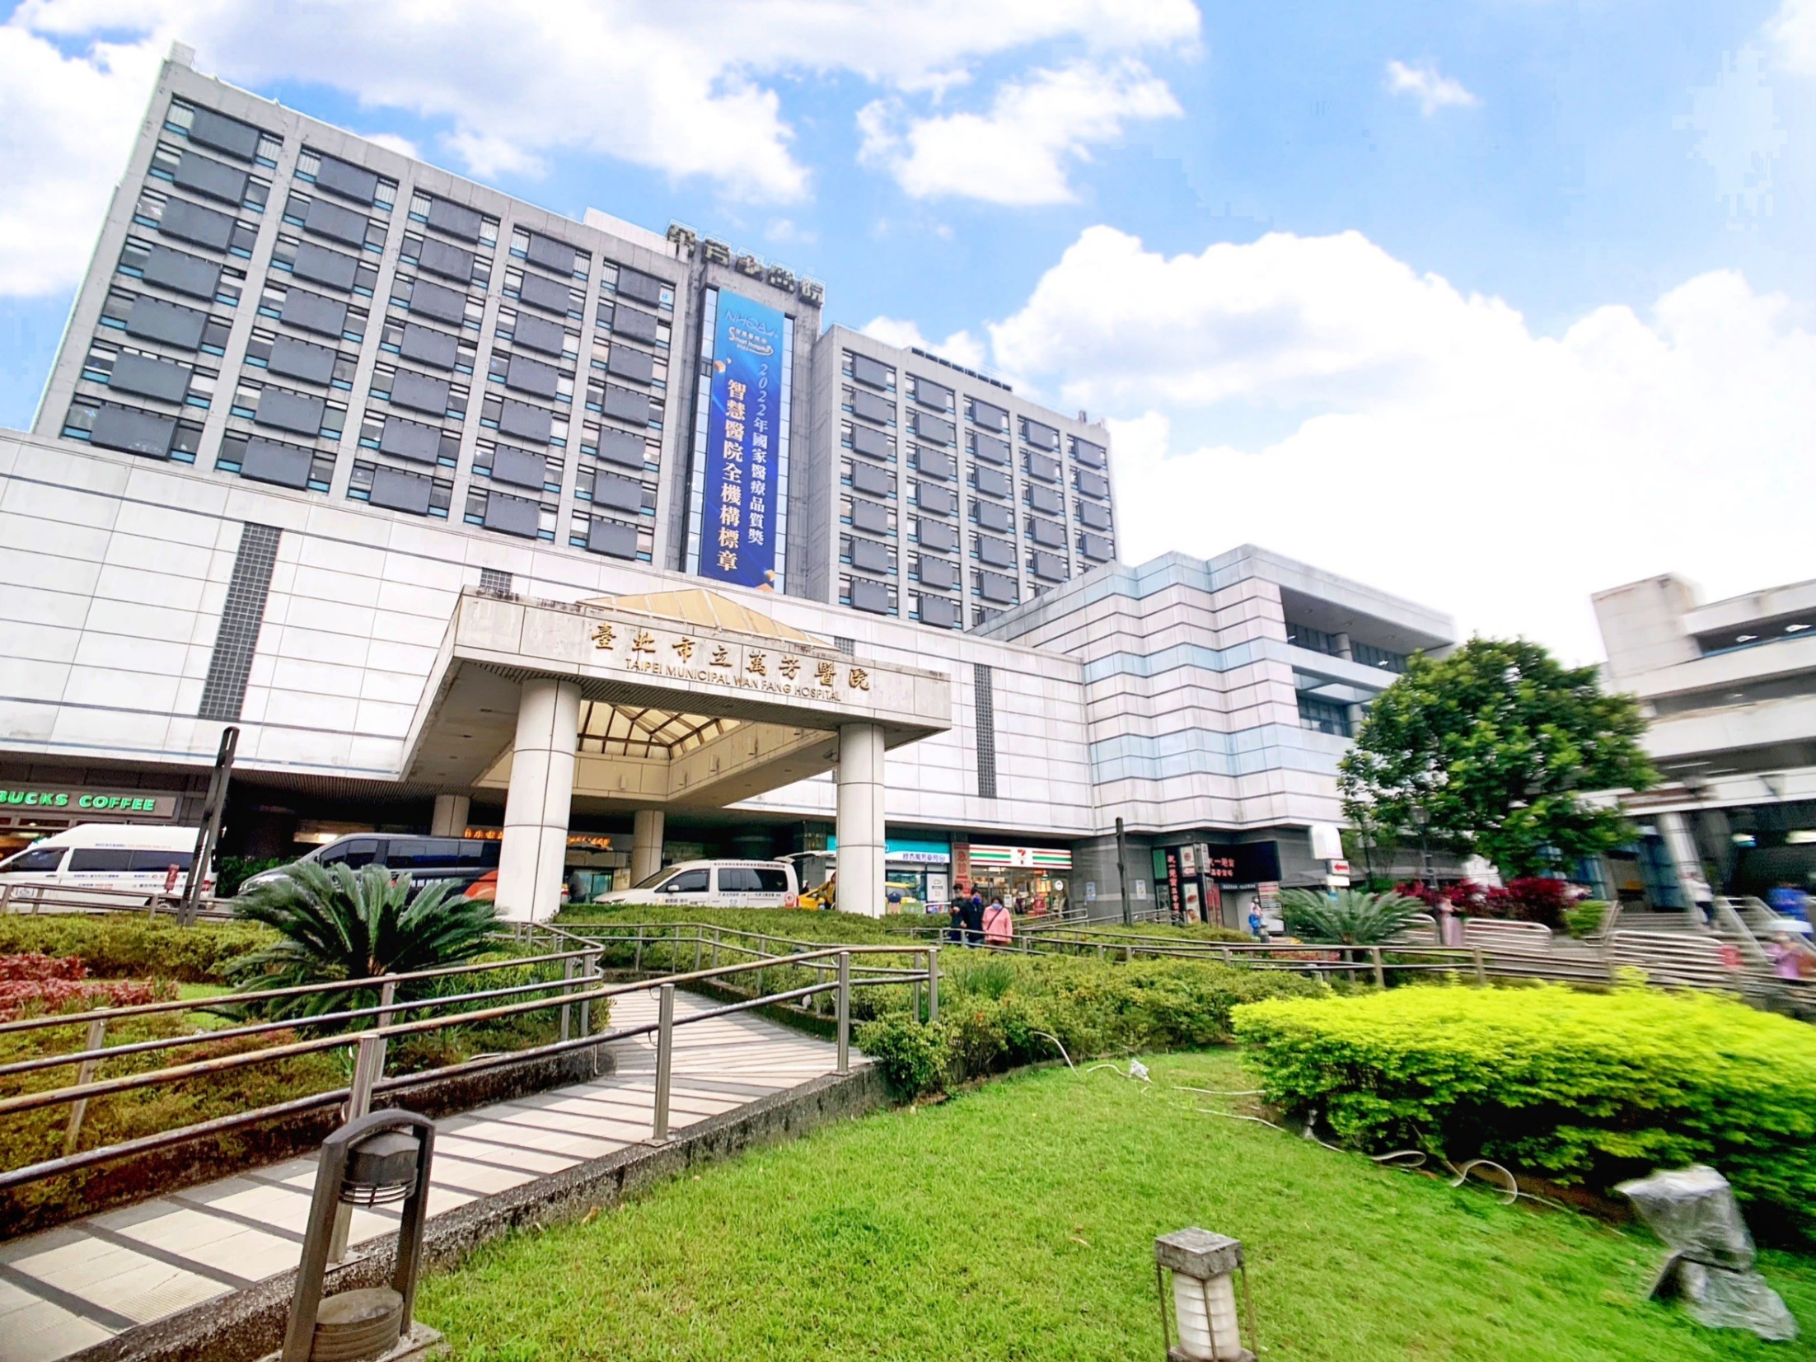
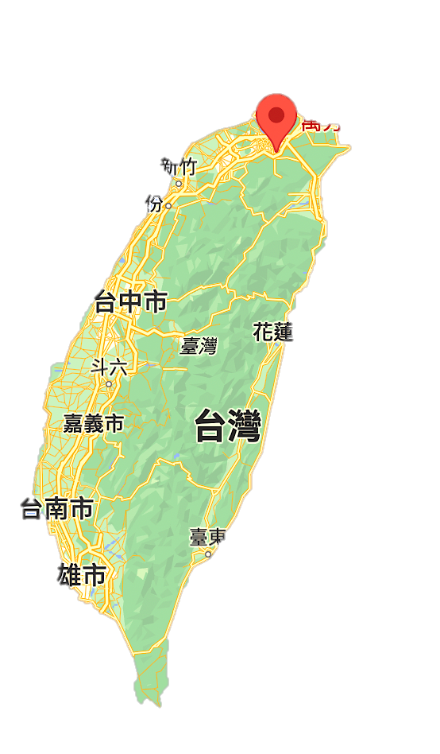
Taipei Municipal
Wan Fang Hospital (WFH)
3

Slide 4

History
2019-2022
2023~
2019-2022
DSC certification program- 13 items
3rd AAHRPP certification
4th Operate-Transfer
5th Hosp. accreditation (Medical Center)
1996
First Operate-Transfer
2003
2014
National Innovation Award- 5 items
Symbol of National Quality- 17 items
NHQA Smart Hospital Award
2nd Operate-Transfer
3rd Operate-Transfer
1997
Open
Hosp. Accreditation
2004
2016
First Hosp. accreditation (Medical Center)
4th Hosp. accreditation (Medical Center)
2001
Class A teaching hospital accreditation
2006
2018
First JCI certification
5th JCI certification
4

Slide 5
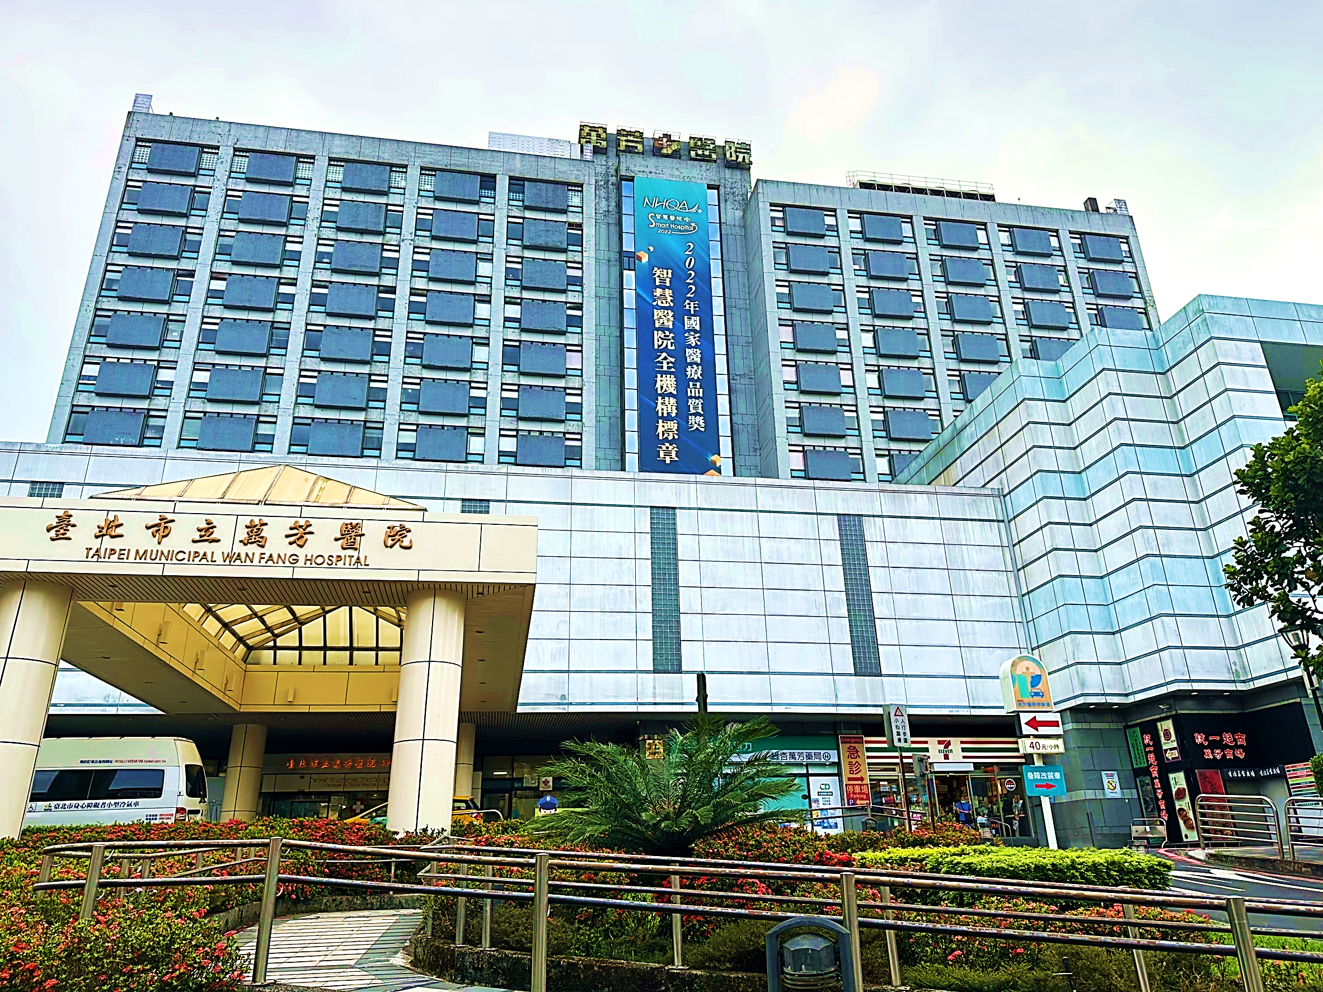
Vision
To be a well-known international high-quality Medical Center
to provide comprehensive medical care for all
5
5

Slide 6

Scales
Category
General ward | Acute care | Acute general bed | 500
 |  | Acute psychiatric bed | 38
 | Sum |  | 538
Special ward | Intensive care unit |  | 50
 | Burn unit |  | 4
 | Negative pressure isolation unit |  | 12
 | Hospice |  | 10
 | Pediatric unit |  | 25
 | Dialytic unit |  | 61
 | Surgical POR |  | 11
 | ER unit |  | 33
 | Others |  | 6
 | Sum |  | 212
Total |  |  | 750
Operation room |  |  | 15
Obstetric room |  |  | 3
Manpower
Category | Number
Physician | 473 (Attending 282、resident 191)
Nurse | 800
Assistant nurse | 61
Medical staff | 366
Administrative | 389
Others | 328
Total | 2,417
HR Database: 2023.06.01
Notes:
實習醫學生，確認是否包括牙醫？

Slide 7

Academy
Attending Physician | Number
professor | 33
Associate professor | 29
Assistant professor | 45
Lecturer | 20
Total | 127
45% of total attending physician
Medical staff | Number
professor | 1
Associate professor | 5
Assistant professor | 12
Lecturer | 31
Total | 49
HR Database: 2023.06.01

Slide 8

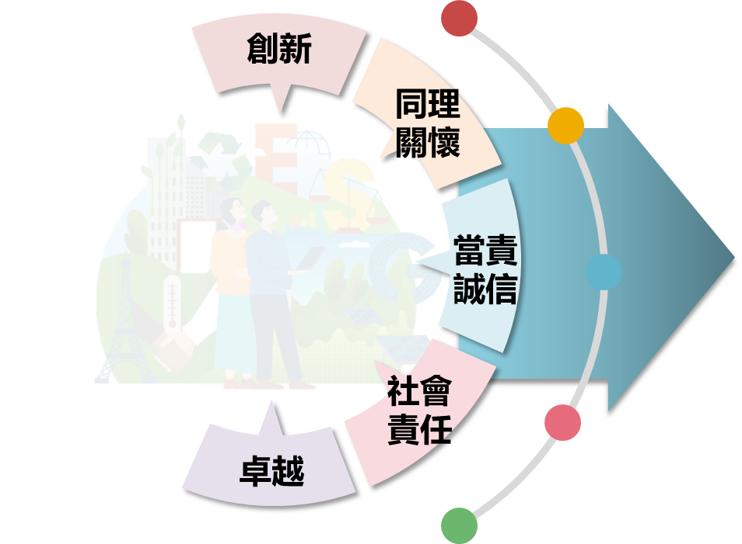

SMART strategy
Hospital management
Community
Social impact
Medicine
Medical competence
VISION
Quality
AI hospital
深耕社區、培育人才、
創新研發、高品質醫療服務
Innovation
Research innovation
Education
Talent development

Slide 9
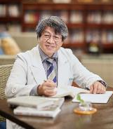
My transplant journey I – MC Lee, M.D.
Transplantation surgery, 1996-2023
Kidney transplantation, visiting research fellow
National Taiwan University Hospital, Taiwan, 1996. (Prof. Lee PH)
Tokyo Women’s Medical University Hospital, Japan, 2008. (Prof. Tanabe K.)
Liver transplantation, visiting research fellow
Thomas E. Starzl Transplantation Institute, University of Pittsburgh Medical Center, USA, 1997. (Prof. Thomas E. Starzl)
Kyoto University Hospital, Japan, 2005. (Prof. Egawa H.)
Clinical transplantation
TCH era (1997.5-2021.6): 173 DDKT, 65 LDKT, 45 DDLT, 36 LDLT
TMU era (2021.8-2023.7): 30 DDKT, 17 LDKT, 6 DDLT, 5 LDLT
Story is still on going

Slide 10
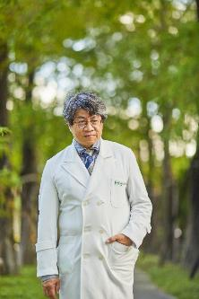
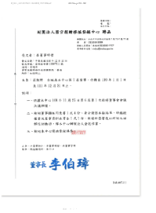
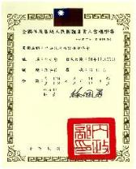
My transplant journey II – MC Lee, M.D.
Transplant organization, 2008
Member of the Council, The Transplantation Society of Taiwan, Taipei, Taiwan, November 2011 – present.
Board of Director, Taiwan Organ Registry and Sharing Center, Taipei, Taiwan, January 2011 – present.
President, Organ Donation Association, R.O.C., September 2017- present.

Slide 11
First organ transplantation in Taiwan
Year | Organ | Institute
1968 | Kidney | National Taiwan University Hospital
1984 | Liver | Chang Gung Memorial Hospital, Linko
1984 | Pancreas | Chang Gung Memorial Hospital, Linko
1987 | Heart | National Taiwan University Hospital
1991 | Lung | Taipei Veteran General Hospital
2007 | Small bowel | Far East Memorial Hospital
Notes:
In 1968, Professor Chung-Jen Lee perforemed the first kidney transplantation in national Taiwan University Hospital using a live donor. In the following 40 years, all the visceral organ transplantation such as liver, pancreas, heart, lung and small bowel has been accomplished and was considered to be a standard treatment of choice for end-stage organ failure patient in Taiwan.

Slide 12
Human Organ Transplantation Act
Promulgated in June 19th 1987, amendment in 2011
Deceased organ is the priority for organ transplantation
Declaration of death regarding to brain death
Rule for brain death declaration in 1987
Guideline for brain death declaration in 2004
Living donor eligibility
Restricted within 3rd degree consanguinity and spouse since 1987
Expanded to 5th consanguinity and spouse since 2002
Notes:
It was three years later following the first liver transplantation that Taiwan government promulgated ‘Human Organ Transplantation Act’ in 1987. It was the first time in Asia to enforce laws regarding brain death. In this Act, it emphasized that the priority of organ source for transplantation would be brain-dead donor. Living donor eligibility was restricted within 3rd degree consanguinity and spouse. But in order to broaden the organ source, the donor eligibility was expanded to 5th consanguinity and spouse in an amendment enacted in 2002. However, organ donations were still small in number and sporadic in the next 15 years. Why?

Slide 13
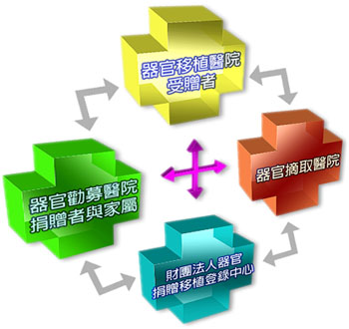
Taiwan Organ Registry and Sharing Center
Recipient hospital
Established on June, 2002
Establishment of an organ procurement network
Registration of deceased donors and recipients
Planning and implementation of organ matching operations after 2005
Education and training for related medical personnel
Promotion of organ procurement education
Donor hospital
OPO
Taiwan Organ Registry and Sharing Center (TORSC)
Notes:
After this miserable event, the Department of Health found and established the “Taiwan Organ Registry and Sharing Center” to organize the registration of organ donation and transplantation in June 2002. Not only all the organ donors and recipients should be registered electronically, but also process of organ allocation was computerized according to the policies since 2005. Base on this fair, open, transparent allocation and registration system, the organ donation rate was increasing up to 10.0 per million population in 2011.

Slide 14
SOP of organ allocation
登錄中心
全國移植資料電腦登錄系統（24小時通報）
TORSC
Waiting List
Organ donation
完成醫學評估後，上網填寫「器官移植等候者登錄表格」
上網填寫「屍體器官捐贈者登錄表格」，電話通知登錄中心，未能於第一次腦死判定後一小時內通報之欄位，應於受贈者接受移植手術七日內完成補登
確認器官捐贈
移植醫院等候者移植資料通報 (需依病情隨時更新)
ALLOCATION - TORSC
2nd declaration of brain death
TH等候者移植資料通報（需依病情隨時更新）
ALLOCATION - OPO
1st declaration of brain death
Inform consent
Organ sharing
移植醫院團
隊進行評估
器官勸募例行探詢
Organ procurement / transportation / transplantation
移植醫院及勸募醫院
發現潛在捐贈者
Donor hospital
移植醫院潛在 等候移植病患Recipient hospital
Post-transplantation
follow-up
Notes:
All the procedure of organ allocation is standardized and computerized. Once a potential donor is identified, the process starts. The OPO staff should register the donor’s data electronically after first time declaration of brain death, and the recipients will be listed according to the allocation policies. Finally, suitable recipients will be informed after clinical interviewing and obtaining inform consent.

Slide 15

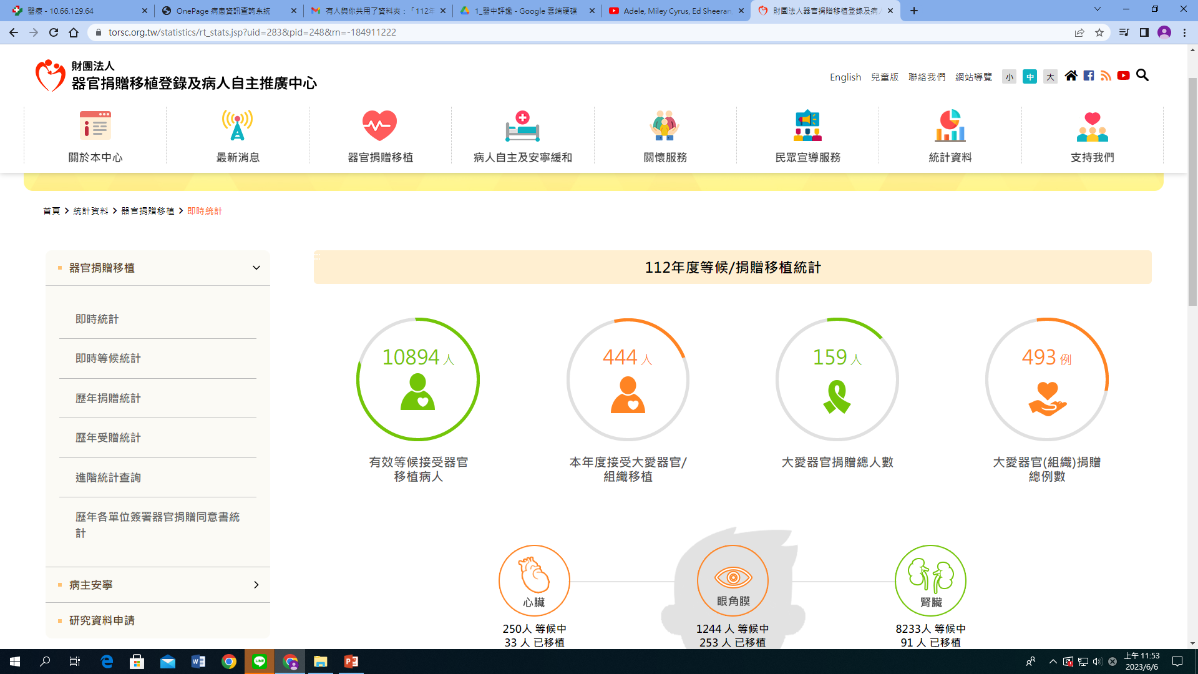
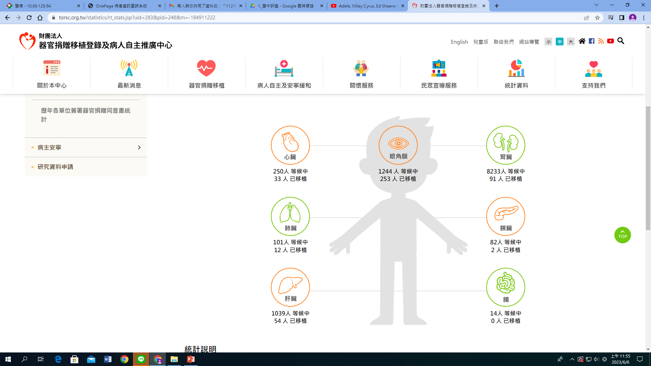
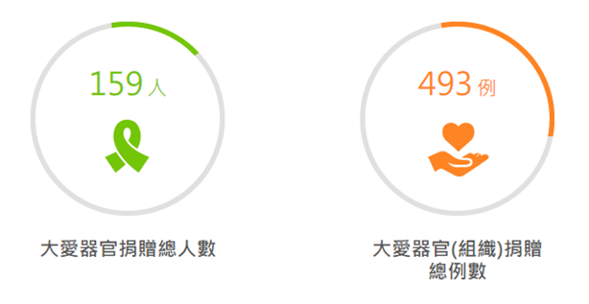
Real time registration data
統計日期: 2023-06-06
(Source: Taiwan Organ Registry and Sharing Center)

Slide 16
Organ donation number in Taiwan
Organ donor number
Tissue
Organ
(Source: Taiwan Organ Registry and Sharing Center)
Notes:
截至目前為止全國累計了近15年的統計數據
我們可以發現
的確每年的器捐人數逐年成長
但如果仔細分析時
我們卻發現了成長的器捐人數大多來自組織的捐贈
而實際臨床上更需要的器官贈數卻成長有限

Slide 17
Organ donation rate in Taiwan (PMP)
tissue & organ Organ only
Online registration, 2005
TORSC, 2002/07
(Source: Taiwan Organ Registry and Sharing Center)
Notes:
我們可以很清楚的從每百萬人口的捐贈率看出
包含組織捐贈的整體器捐率雖然可達每百萬人口15.2人
但是僅計算器官捐贈人數時
幾年來依然停留在每百萬人口5到6人之間

Slide 18
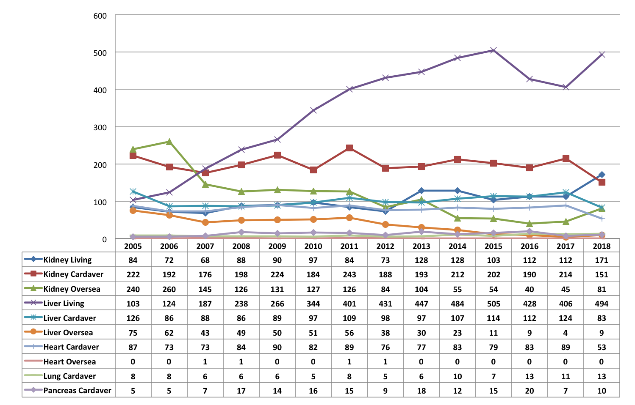
Organ Transplantation in Taiwan
(Source: Taiwan Organ Registry and Sharing Center)
Notes:
醫界大老沈富雄醫師曾說過 全世界有三種國家
第一種是有錢而且有氣質的國家 這種國家的人民捐出自己的器官救自己的同胞
第二種是沒錢也沒氣質的國家 這種國家很可憐 往往為了家庭生計販賣自己的器官
第三種是有錢但沒氣質的國家 這種國家的人拿著錢去貧窮國家買器官
過去台灣的移植個案有為數不少是在境外移植
政府雖然于近10年來致力於改善台灣的器捐環境
從數據上可以看得出來境外移植數目逐年減少
但仍無法完全避免這類移植案例的發生
正所謂 自己的國家應該自己救
我們除了應該要努力的去改善器捐環境外 更重要的是要能獲得社會大眾的支持
透過專業、公開、且感同身受的臨床行為
讓病人及家屬能感受到尊重 願意響應器官捐贈
讓器官來源能夠自給自足
也能讓國民體會這樣一種善與愛的循環正是國家社會進步的動力

Slide 19
Kidney transplantation in Taiwan
2005-2022 Kidney transplantation (oversea transplantation excluded)
Deceased donor Living donor
(Source: Taiwan Organ Registry and Sharing Center)

Slide 20

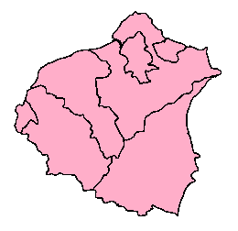
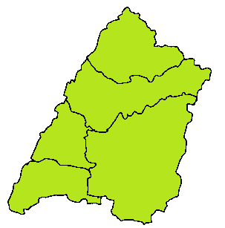
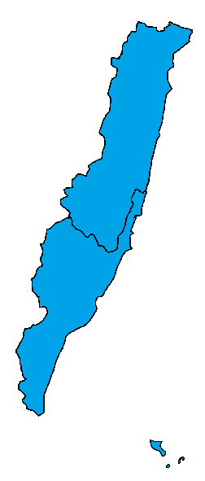
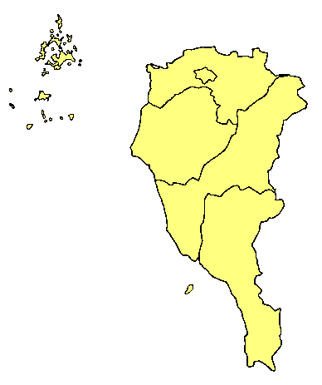
Organ Procurement Organization in Taiwan
Northern Taiwan OPO
20% area, 45.6% population
Northern Taiwan OPO (NTOPO)
National Taiwan University Hospital
Tri-service General Hospital
Taipei Veteran General Hospital
Chang Gang Memorial Hospital, Linko
Far East Memorial Hospital
Wan Fang Hospital, TMU
Central Taiwan OPO
Organ |  | Transplant center
Heart |  | 10
Lung |  | 6
Liver | deceased | 13
 | living | 8
Pancreas |  | 4
Intestine |  | 2
Kidney |  | 17
Cornea |  | 19
Eastern Taiwan OPO
Southern Taiwan OPO
Notes:
Now four OPOs regarding to their geographic distribution were contrasted by TORSC. The major hospitals in each region should cooperative to the OPO to promote organ donation. The OPO should arrange the educational activities in issue of organ donation and transplantation to the related hospitals.

Slide 21
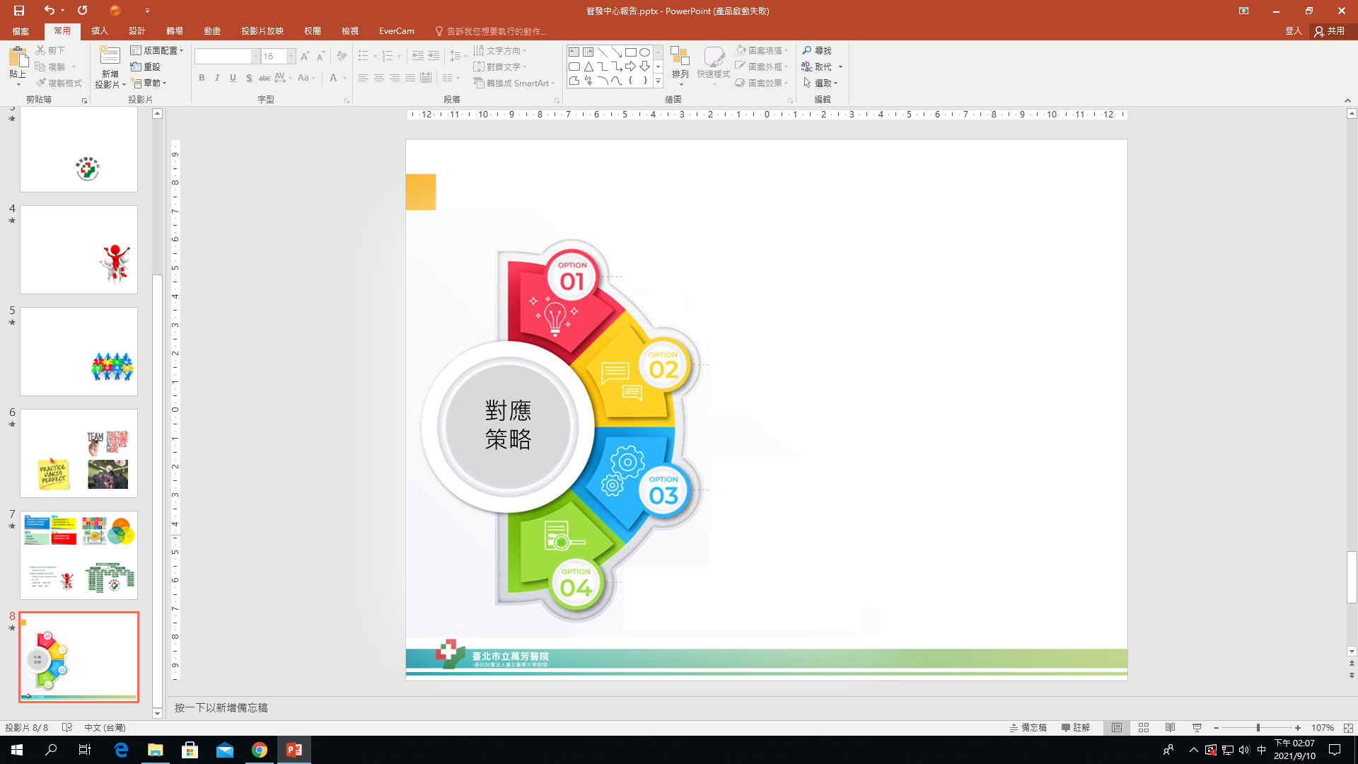
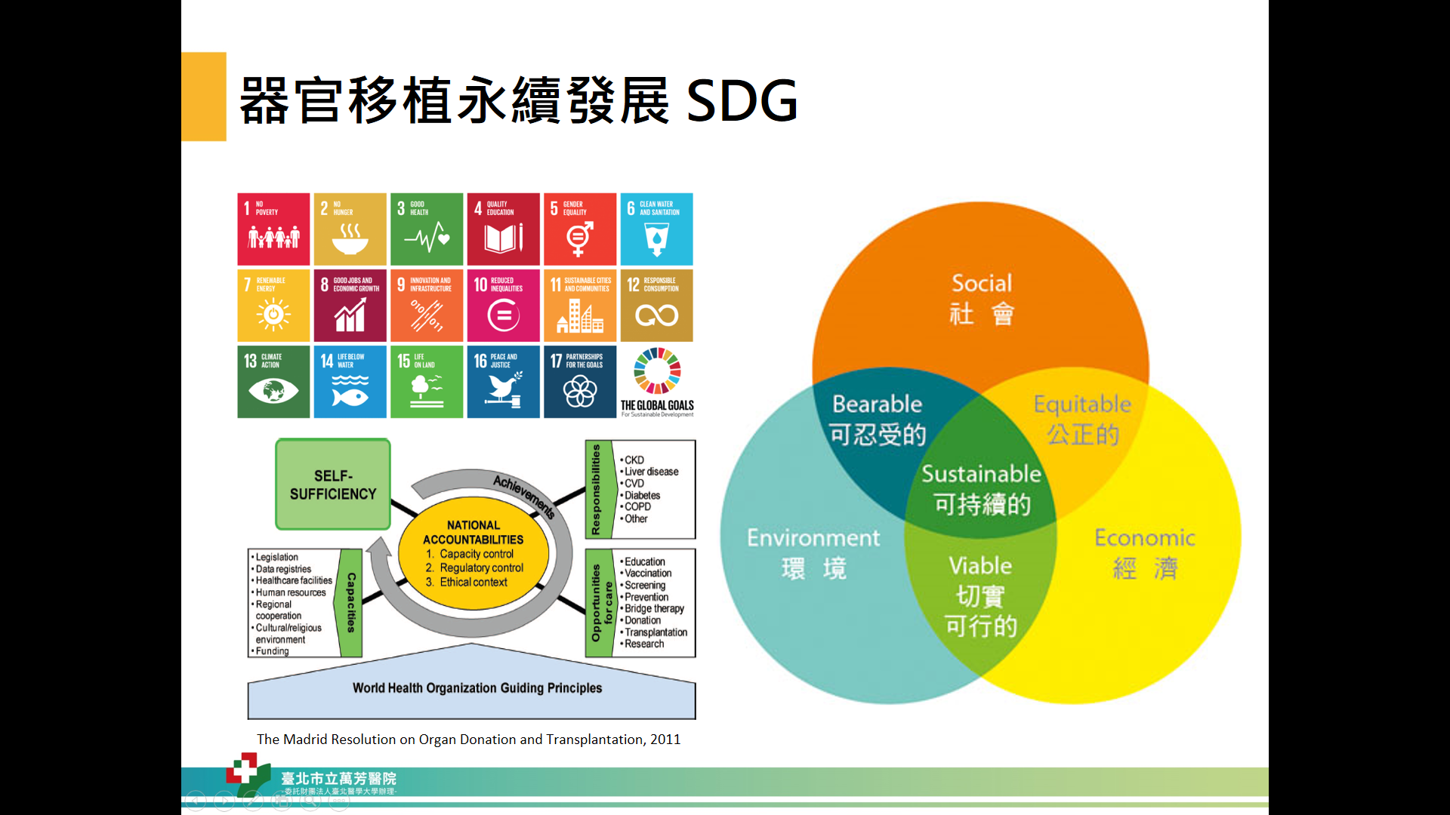
Strategy
戰略
方針
SWAT
戰略
方針
SDG
戰略
方針
4 S’
戰略
方針
Structure
戰略
方針
Service

Slide 22

Research Center for Organ Transplantation (RCOT)
TMU-RCOT
Transplantation
Donation
Surgery
Medicine
Administ.
Recovery
Family counseling
Support team
TMUOPO
TX Surgery
CV
General affair
Coordinator
Community
Neuro
Urology
Chest
Social worker
Social worker
Hospital
NS
CVS
GI
Volunteer
TX Surgery
CS
Nephrology
CV
PS
ID
Resp. Therapy
Ortho
MICU
SICU
Ophthal.
Pathology
MICU
Anesthesia
Hospice
Radiology
SICU
Central Lab.
OR
Virus Lab.
Serology Lab.

Slide 23
Organ transplantation and donation committee
OTDC-WH
Tissue bank
Transplantation
Donation
Surgery
Medicine
Administ.
Recovery
Family counseling
Support team
TX Surgery
CV
General affair
Coordinator
Community
Neuro
Urology
Chest
Social worker
Social worker
Hospital
NS
CVS
GI
Volunteer
TX Surgery
CS
Nephrology
CV
PS
ID
Resp. Therapy
Ortho
MICU
SICU
Ophthal.
Pathology
MICU
Anesthesia
Hospice
Radiology
SICU
Central Lab.
OR
Virus Lab.
Serology Lab.

Slide 24
TMU-RCOT
OTC: organ transplantation center
OPC: organ procurement center
OTDC: organ transplantation and donation committee
TMU
Affiliation
TMU-RCOT
Partnership
Transplantation center
Procurement center
TMU-OPO
TMUH
OTC
Wan Fang
OTC
Shuang Ho
OTC
Shuang Ho
OPC
Wan Fang
OPC
TMUH
OPC
Non-affiliated
partnership
Shuang Ho OTDC
Wan Fang OTDC
TMUH OTDC

Slide 25
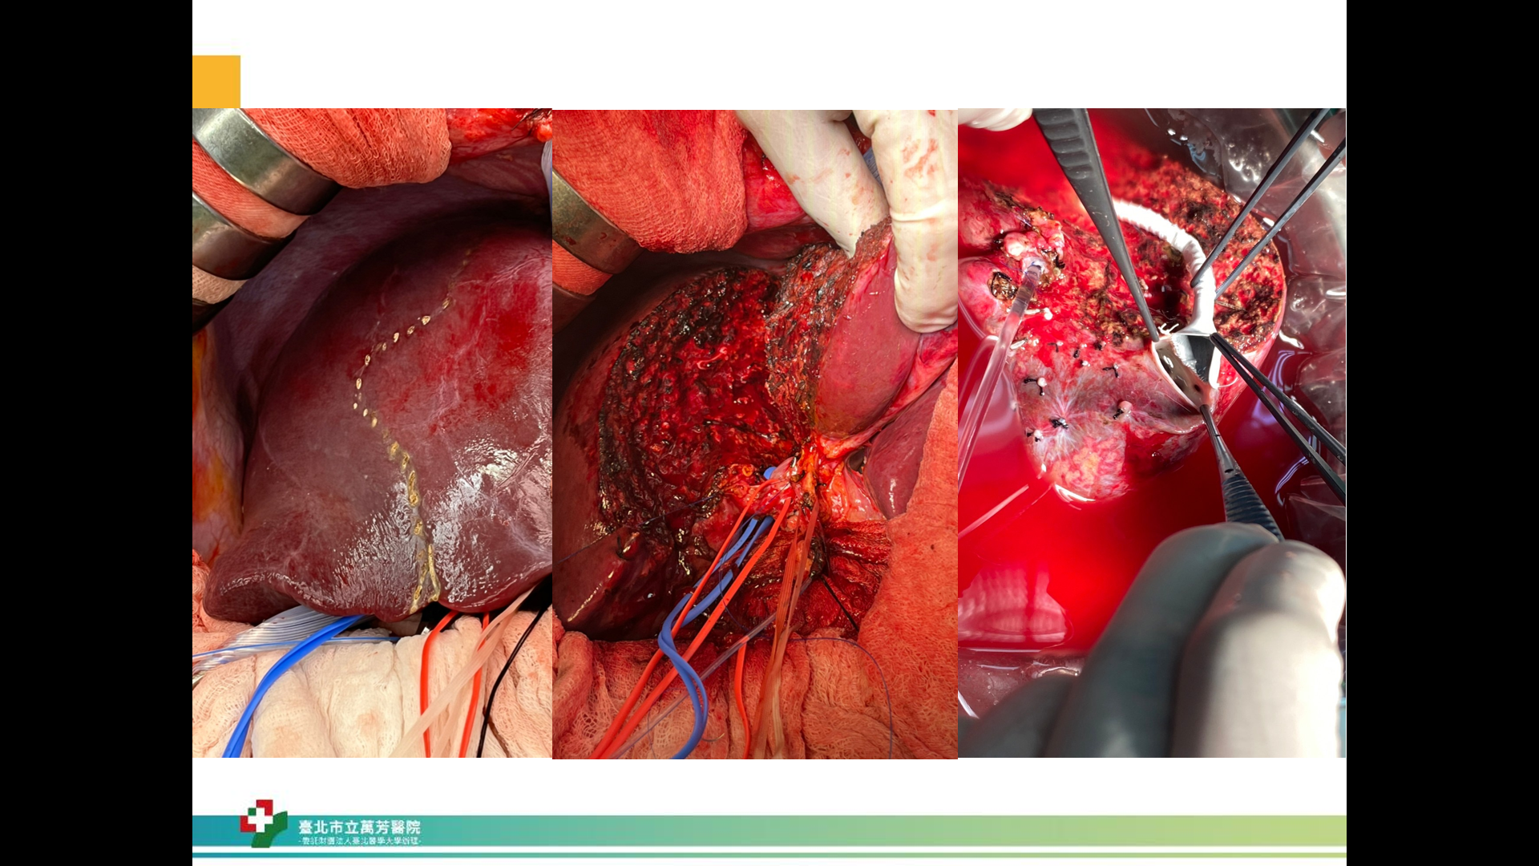
Transplant team members in WFH
Transplant surgeons
4 KTX, 2 LTX, 2 HTX
Team work is crucial
Optimal team approach
Perfect surgical technique
Practice makes perfect

Slide 26
Organ donation in WFH
Organ donation |  | Number
Organ donor (N) |  | 5
Donation after brain death (DBD) |  | 3
Donation after circulatory death (DCD) |  | 0
Donation after death |  | 2
Donated organ/tissue (N) | Heart | 3
 | Lung | 0
 | Liver | 3
 | Kidney | 6
 | Pancreas | 0
 | Intestine | 0
 | Bone | 1
 | Cornea | 10
 | Skin | 1
 | Others (vessels, tendons, etc.) | 0
(Period: 2023.01.01-20230630)

Slide 27
Organ transplantation in WFH
Organ transplantation |  | Number
 |  | 38
Deceased donor organ transplantation | Heart transplantation | 3
 | Lung transplantation | 0
 | Liver transplantation | 4
 | Kidney transplantation | 5
 | Cornea (domestic) | 15
 | Cornea (foreign) | 7
Living donor organ transplantation | Liver transplantation | 3
 | Kidney transplantation | 1
(Period: 2023.01.01-2023.08.10)

Slide 28

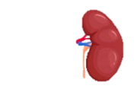
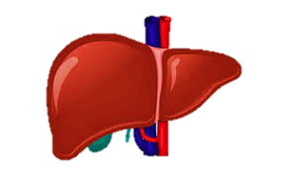
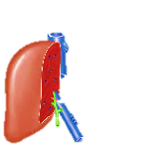
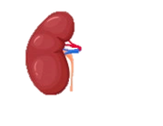
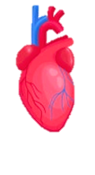
WFH milestone in organ transplantation
2021-09-24 First donation after circulatory death
2021-11-09 First live donor kidney transplantation
2021-12-19 First deceased donor liver transplantation
2022-08-23 First live donor liver transplantation
2022-11-08 First ABO-incompatible kidney transplantation
2023-03-09 First heart transplantation
2021-2023 DDLT(6), LDLT(5), DDKT(9), LDKT(8), HT (3)

Slide 29



I-CARE
～Thanks you
Innovation
Compassion
Accountability & Integrity
Responsibility for society
Excellence
Medical Quality is Our Pride

